Slide 1

The Egyptian E-Learning University (EELU)
Faculty of Computer & Information Technology
EELU- Aswan2024

Slide 2
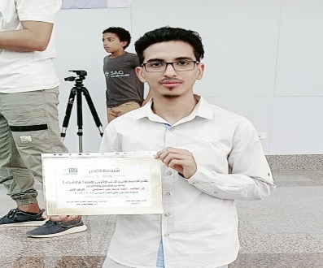
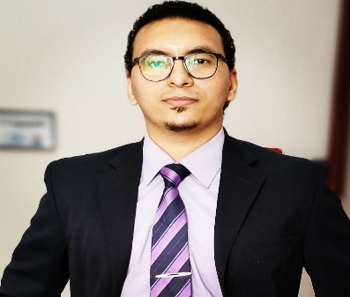
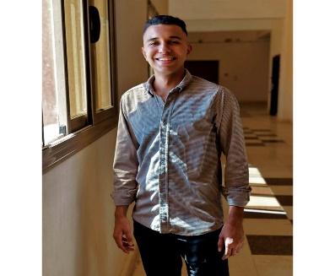
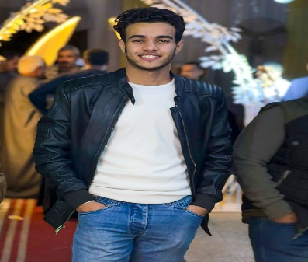
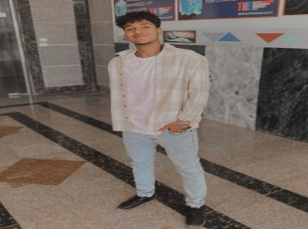
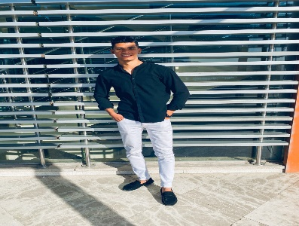
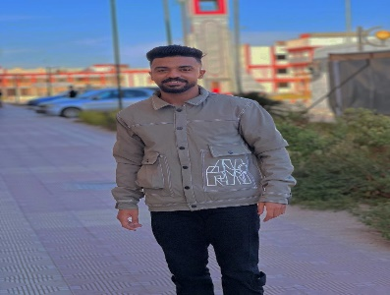
Team members:
Ahmed Mohamed Ali
20-01001
Taha Mohamed Ali
20-00999
Mohamed Abdel Baset
20-01028
Abdul Rahman Mahmoud
20-01306
Bassam Abbas Sharif
20-00477
Mohamed Talaat Bakhit
20-02049
Mohamed Ahmed Ali
20-01721

Slide 3
Under Supervision of:
Eng: Hams Khaled | Dr: Ahmed Hamza
Teaching Assistant of Computer and Information Technology Egyptian E-Learning University | Assistant Prof of Computer and Information Technology Egyptian E-Learning University
We would like to thank you for your great help and effort that made us excel in this project. Thank you very much….

Slide 4
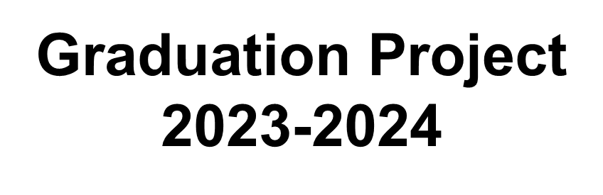
Smart stick for visually impaired people

Slide 5
Smart
Stick
Smart stick for visually impaired people
ALLPPT.com _ Free PowerPoint Templates, Diagrams and Charts

Slide 6
Abstract:
After statistics, we found that there are many blind people all over the world who suffer from difficulty dealing with and moving in the outside world, so we decided to design this stick in order to help these people and make life easier for them.
Our first and last goal is to help this country thrive through modern technology.

Slide 7
Outline
Introduction
motivation
Objectives
problem Definition
solutions
Challenges
Solutions
The main beneficiary of our project
Project life cycle
Related Work
Types of deep network algorithms
YOLO
METHODOLOGIES and APPROACH
TIME PLAN AND Responsibility
Present Work

Slide 8
Outline
16 Prototype
Mobile application
distance Measurement
Voice interaction
Practical experience
TIME PLAN AND Responsibility
CONCLUSIONS
References

Slide 9
1.Introduction
Smart Blind Stick is an interactive device which mainly aims at helping the blind to navigate easily and in a safer manner.
In a normal day to day situation a blind person waves the
blind stick ahead of them in order to check for any objecs or obstacles.
The smart stick helps them in this by detecting if any obstacle is blocking the path being taken by the subject.
The device detects the obstacle with the help of a camera attached to the front of the stick.
On detection of the obstacle, it is identified and appropriate instructions

Slide 10
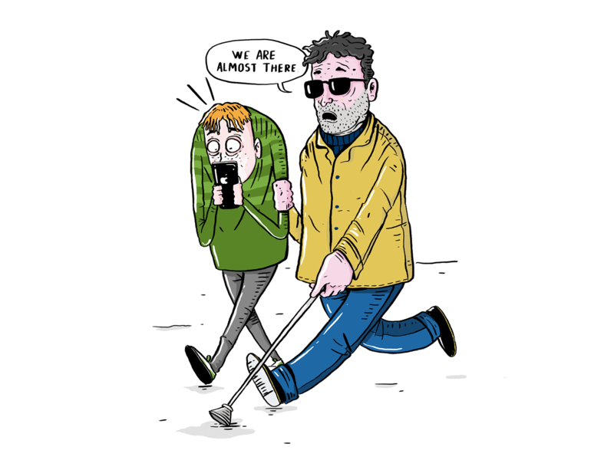
2.motivation
Smart stick for blind people.
After seeing the blind people in the street pleasing people to help them walk on street. I felt sad for that, and then
started working on this project.

Slide 11
3.Objectives
1- Facilitating the Self-education process.
2- Facilitating the interaction process.
3- Increasing self-confidence among blind people.
4- Enabling an equal life for the blind.
5- Facilitating the communication process.

Slide 12
4.problem Definition
General global statistics
The number of blind people in the world is currently estimated at 45 million.The number of visually impaired people (the degree of vision is limited in the better eyes) is estimated at 135 million(B)
The percentage of people with disabilities in the world
today has increased:
The World Health Organization estimates that more than
one billion people worldwide suffer from nearsightedness
or long-sightedness(A)

Slide 13
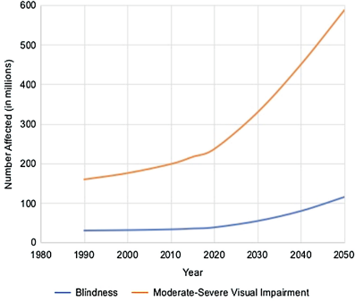
4.problem Definition
Ahmed Al-Maraghi, editor-in-chief of the Egyptian Al-Akhbar Braille magazine(C)
said that Egypt is classified as one of the Arab countries with the largest number of blind people on its soil, reaching 1,800,000 visually impaired people. There are 8 million blind people in the Arab world and 45 million in the world.

Slide 14
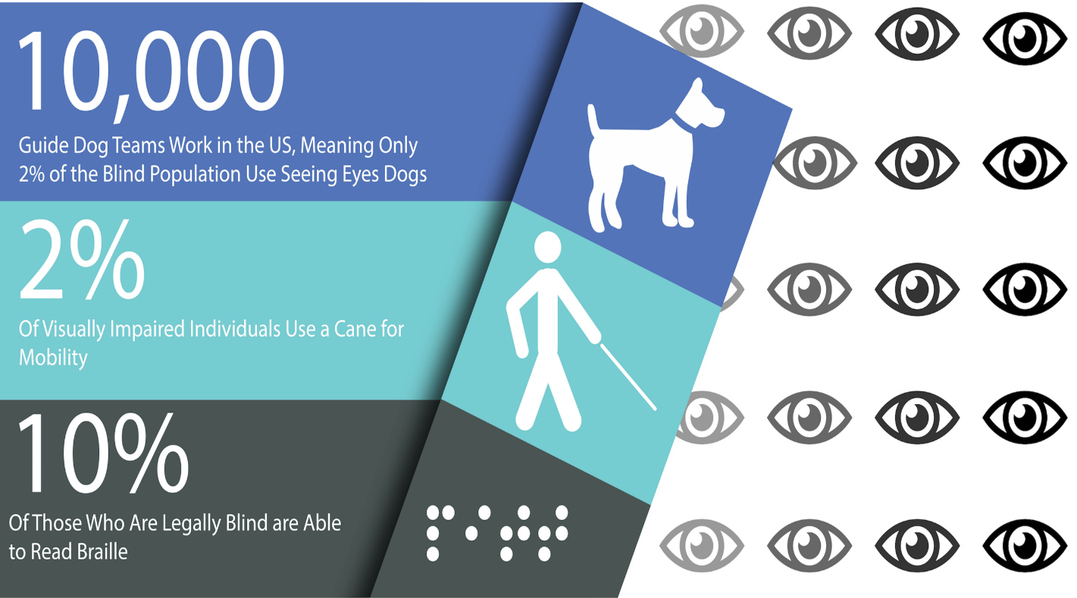
4.problem Definition
Blind people depend on several methods to move around safely and independently. These are traditional solutions
White stick
Guide dogs
Engraving on floor, doors and signs

Slide 15
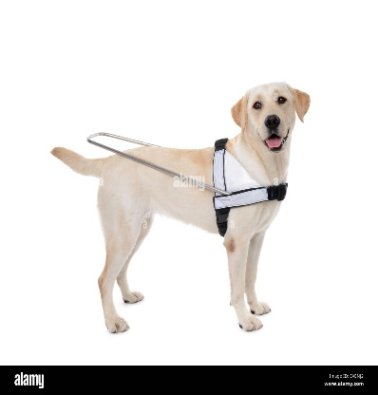

4.problem Definition
Problems
Statistics have shown that a small percentage of
blind people use traditional solutions
In addition, it is full of flaws
Finally, it is unexpected. The dog, the stick, and the inscriptions may let you down.

Slide 16

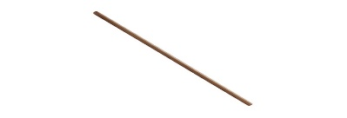

5.solutions
Solutions
The first and last solution is the smart stick.
Why ?
It solves all the problems of traditional solutions
Comfortable and lightweight
Safe, accurate and responsive
It is also cheap and effective
Finally, it is a smart tool that does not require care

Slide 17
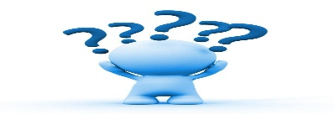
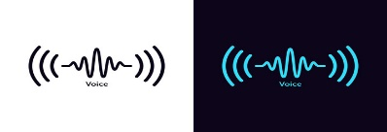

6.Challenges
in the beginning:
Object Detection
Auditory Feedback
Customizable Speech Delay

Slide 18
7.Solutions
after that
The code utilizes the YOLO algorithm to detect and identify objects in real-time from the camera feed. This helps blind people gain awareness of their surroundings, including the presence of objects.
The code converts the object count information into speech using the gTTS library. By providing auditory announcements of the detected objects, blind individuals can receive real-time feedback about the number and type of objects around them.
The code includes a speech delay feature (controlled by the speech_delay variable) that introduces a pause between each object count announcement. This feature may be useful for blind individuals to have sufficient time to process the auditory information before the next announcement occurs.

Slide 19
8.The main beneficiary of our project
Who wish for the opportunity to interact with the world without the help and pity of others
1
Blind people in general ,specifically Those who suffer from complete loss of vision.
2
All ages who like to rely on themselves in movement (young people and any one).
3
Children and the elderly who suffer from poor vision.

Slide 20
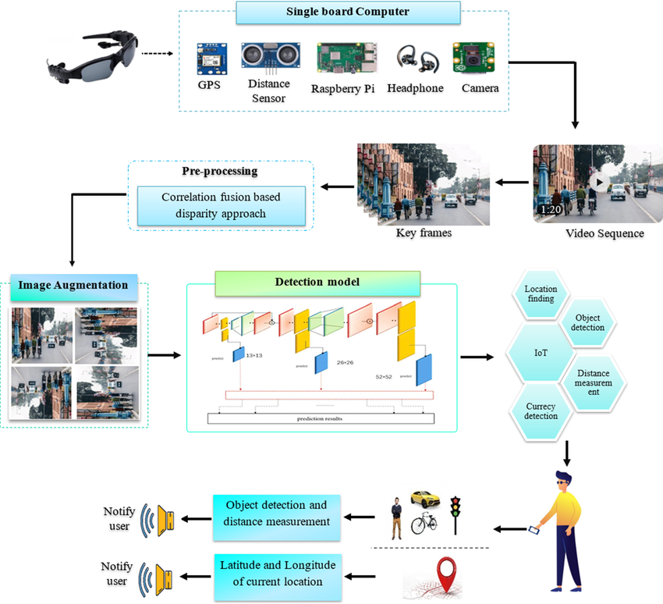
9.Project life cycle

Slide 21



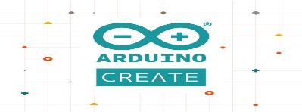
10.Related Work
Ultrasonic Blind Walking Stick
Smart Blind Stick
Obstacle-Detecting
Arduino Blind Stick

Slide 22
11.Types of deep network algorithms
Algorithm | Description | Advantages | Disadvantages
FNN | Feedforward Neural Network | Fast execution | Low accuracy
CNN | Convolutional Neural Network | High accuracy | Moderate speed
RNN | Recurrent Neural Network | Sequential data handling | Slow execution
LSTM | Long Short-Term Memory | High accuracy | Slow execution
GRU | Gated Recurrent Unit | Satisfactory accuracy | Slow execution
GAN | Generative Adversarial Network | Synthetic data generation | Slow execution, varied accuracy
Reinforcement Learning | Reinforcement Learning | Interactive learning, sequential decision-making | Slow execution, variable accuracy
YOLO | You Only Look Once (object detection) | High speed | Moderate accuracy

Slide 23
12.YOLO
Why yolo?:
YOLO's algorithm maintains a balance between accuracy and
speed
For blind people, speed is a crucial factor

Slide 24
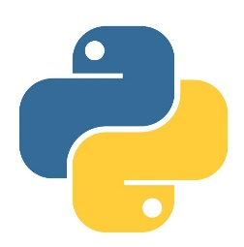


13.METHODOLOGIES and APPROACH
A. Importing Libraries:
The code starts by importing various Python libraries
required for different tasks, such as
random,
time,
playsound,
gtts (Google Text-to-Speech),
os,
cv2 (OpenCV),
and ultralytics (YOLO implementation).

Slide 25
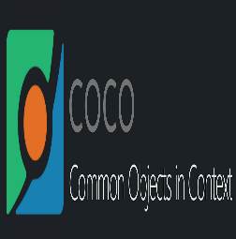
13. METHODOLOGIES and APPROACH con…
B. Reading Class List:
The code reads a text file containing a list of classes
(labels) for object detection. It opens the file, reads its contents, and splits it into a list of classes.
my_file = open("utils/coco.txt", "r")
data = my_file.read()
class_list = data.split("\n")
my_file.close()

Slide 26
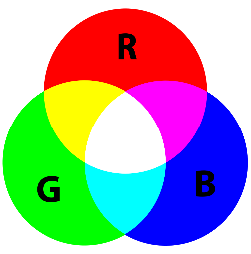
13. METHODOLOGIES and APPROACH con…
C. Generating Random Colors:
The code generates random colors for each class to be used for drawing bounding boxes around detected
objects. It creates a list of random RGB color tuples.
detection_colors = []
for i in range(len(class_list)):
r = random.randint(0, 255)
g = random.randint(0, 255)
b = random.randint(0, 255)
detection_colors.append((b, g, r))

Slide 27

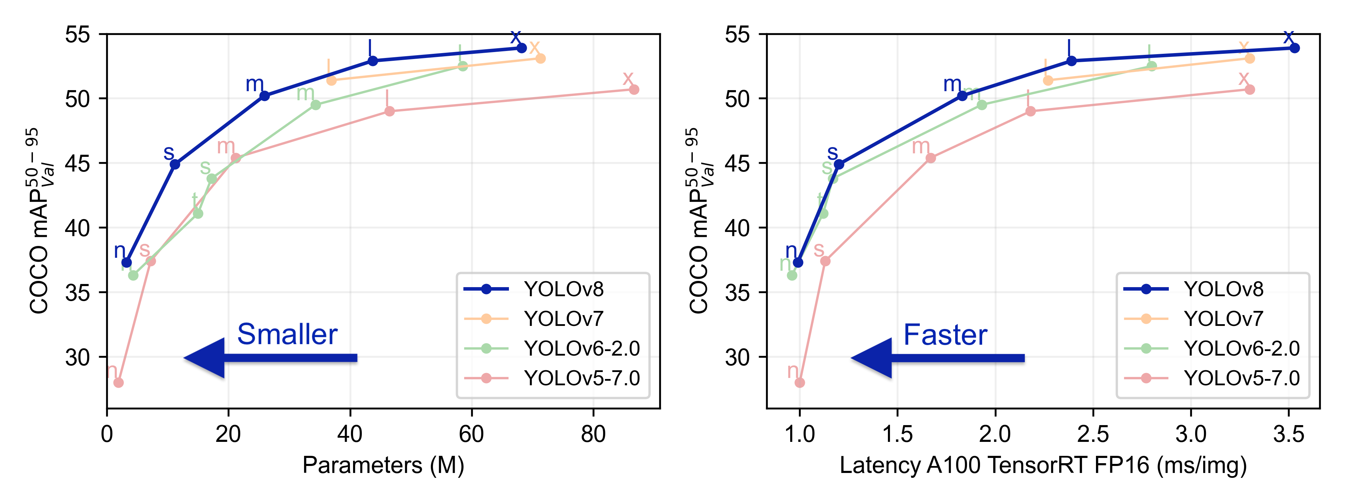
13. METHODOLOGIES and APPROACH con…
D. Loading the YOLO Model:
The code initializes an instance of the YOLO model by providing the paths to the model weights file and the configuration file.
model = YOLO("weights/yolov8n.pt", "v8")

Slide 28
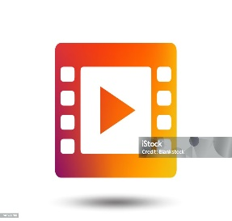
13. METHODOLOGIES and APPROACH con…
E. Setting up Video Capture:
The code opens a video capture object to read frames from the camera. If the camera cannot be opened, it
prints an error message and exits.
cap = cv2.VideoCapture(0)
cap = cv2.VideoCapture("inference/videos/colage.mp4")
if not cap.isOpened():
print("Cannot open camera")
exit()

Slide 29
13. METHODOLOGIES and APPROACH con…
F. Object Detection Loop:
The code enters a while loop to continuously read
frames from the camera and perform object detection on each frame.
Discovery
Frame
Discovery
Frame
Discovery
Frame
while True:
# Cap frame-by-frame
reta, frame = cap.read()

Slide 30
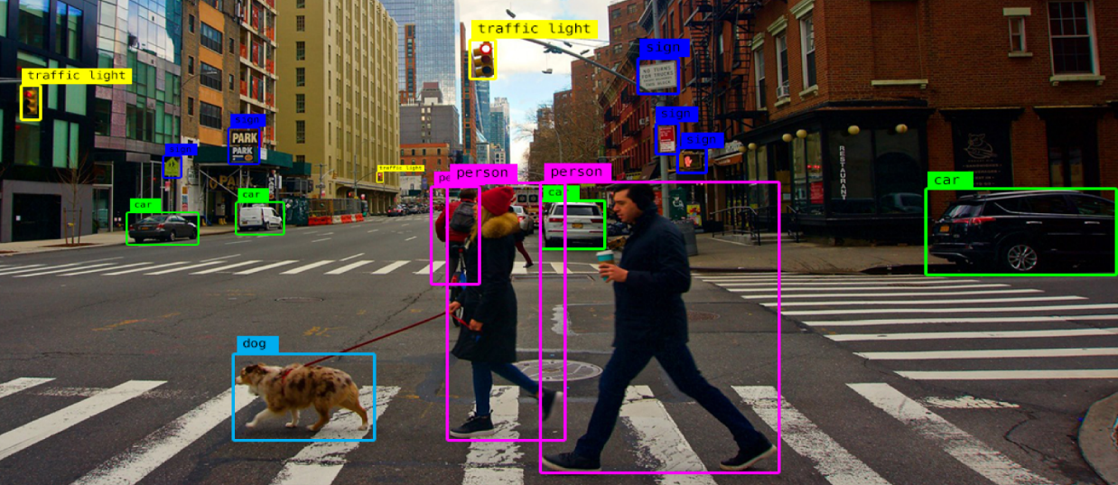
13. METHODOLOGIES and APPROACH con…
G. Object Detection using YOLO:
Inside the loop, the code uses the YOLO model to
perform object detection on the current frame. It sets a confidence threshold of 0.6 and retrieves the
detection results.
detect_params = model.predict(source=[frame], conf=0.6, save=False)

Slide 31
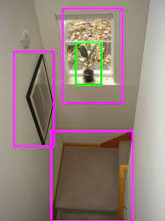
13. METHODOLOGIES and APPROACH con…
H. Drawing Bounding Boxes:
For each detected object, the code retrieves the
bounding box coordinates, class ID, and confidence. It draws a rectangle around the object on the frame and displays the class label and confidence percentage.
boxes = detect_params[0].boxes
box = boxes[i] # returns one box
clsID = box.cls.numpy()[0]
conf = box.conf.numpy()[0]
bb = box.xyxy.numpy()[0]
cv2.rectangle(
frame,
(int(bb[0]), int(bb[1])),
(int(bb[2]), int(bb[3])),
detection_colors[int(clsID)],3,)

Slide 32
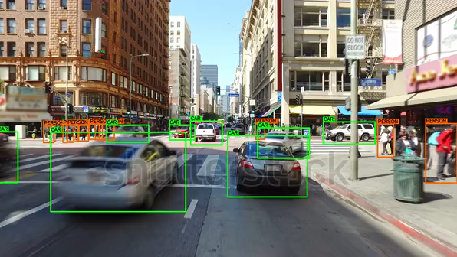
13. METHODOLOGIES and APPROACH con…
Explanatory video:

Slide 33
13. METHODOLOGIES and APPROACH con…
I. Counting Objects:
The code keeps track of the count of each detected
object class in the current frame. It compares the
current count to the previous count to determine if
there is a change.
for i in range(len(class_list)):
if current_object_count[i] != prev_object_count[i]:
prev_object_count[i] = current_object_count[i]

Slide 34
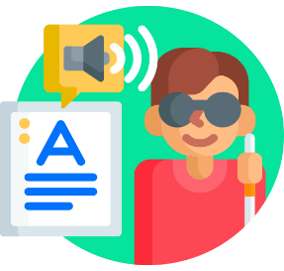
13. METHODOLOGIES and APPROACH con…
J. Text-to-Speech Announcement:
If there is a change in the object count, the code
generates a text-to-speech audio file announcing the
count of the detected objects. It uses gTTS to convert
the text to speech, saves the audio file, plays it using
playsound, and removes the audio file.
if current_object_count[i] != 0:
object_count_text = str(current_object_count[i])
+ " " + class_list[i] + " detected"
obj = gTTS(text=object_count_text, lang='en', slow=False)
obj.save("audio/object_count_{}.mp3".format(i))

Slide 35
13. METHODOLOGIES and APPROACH con…
K. Displaying the Frame and Handling User Quit:
The code shows the frame with the bounding boxes
and text overlays using OpenCV's imshow function,
waits for the 'q' key to be pressed to exit the program.
cv2.imshow("ObjectDetection", frame)
if cv2.waitKey(1) == ord("q"):
break

Slide 36
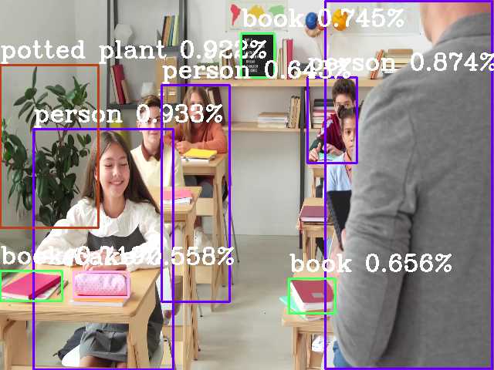
Project video

Slide 37
14.TIME PLAN AND Responsibility
First semester
1 week
1- the problem was extensively researched and all answers were studied.
5 weeks
1 weeks
3 weeks
2 weeks
3- Determine the appropriate algorithm (YOLO-v8n)
2- Start Study :- * Deep learning * Machine learning * Computer vision algorithm
* Voice recognition
4- The object detection phase has been completed
5- The voice recognition phase has been completed(add TTS)
* Text to speech(TTS)
* Start writing the code

Slide 38

15. Present Works
Mobile application
distance Measurement
Voice interaction

Slide 39


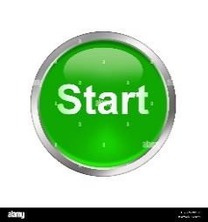
16. prototype
The prototype was finalized in Python
Tested and tried
Appropriate improvements have been made
The present work has been started

Slide 40
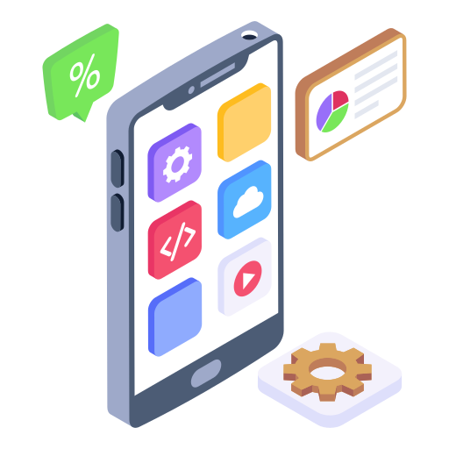
17. Mobile application
The best solution for blind people
1. No blind man is without a smart phone
2. The smartphone is easy to carry
3. It contains many features to support the blind

Slide 41
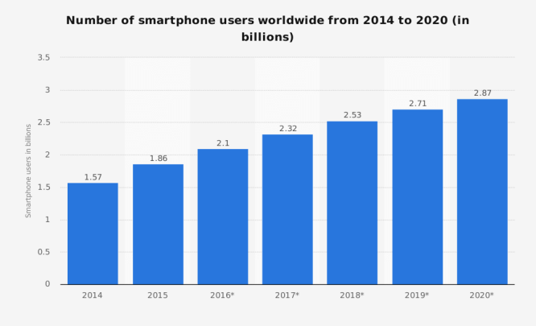
17. Mobile application
Global statistics

Slide 42

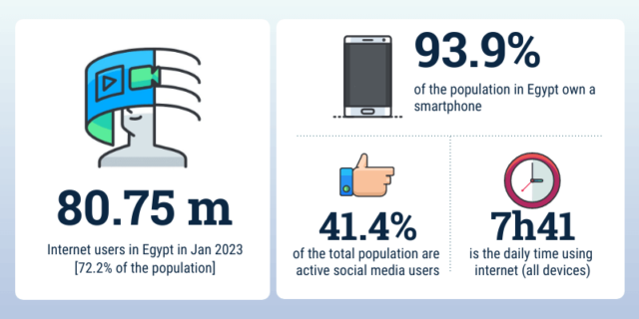
17. Mobile application
According to the Ministry of Communications
and Information Technology
about 98.8% of Egyptian families own a mobile phone, and about 93.9% of individuals use mobile phones. In
January 2023, there were 105 million mobile
connections in Egypt

Slide 43
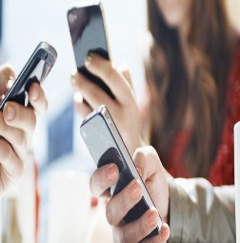
17. Mobile application
No home is without a smartphone these days

Slide 44
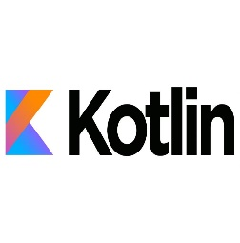
17. Mobile application
Kotlin programming language was used to build the application

Slide 45
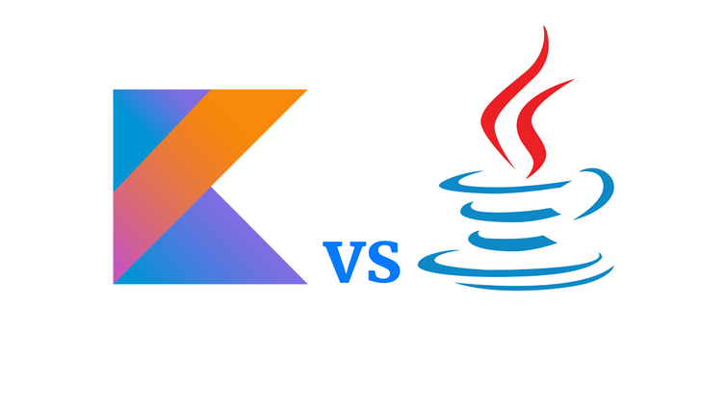
17. Mobile application
Kotlin requires fewer lines of code as compared to java

Slide 46
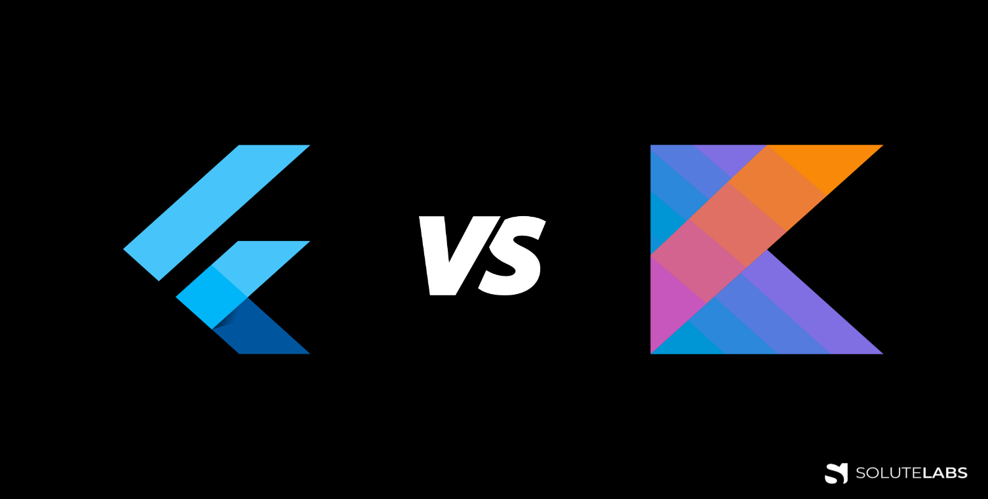
17. Mobile application
Kotlin for Android offer native performance, as
they are specifically designed for their respective
platforms. This can result in faster and more efficient apps compared to Flutter

Slide 47
18. distance Measurement
we researched the topic of distance calculation in depth and found some common and widely used methods:
Using a three-dimensional (3D) camera:
Using Depth Sensors:
Optical information:
Training AI models to estimate distance:
Calculate distance based on object sizes and boundaries :

Slide 48
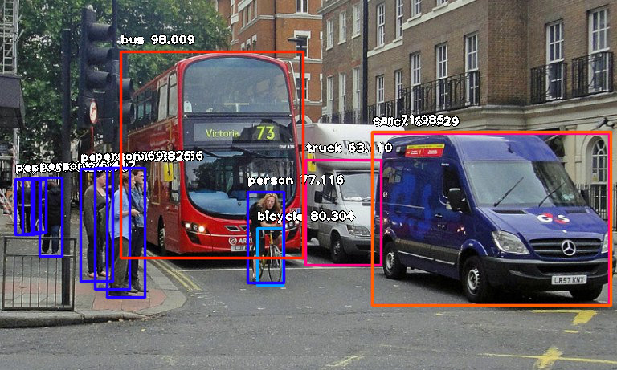
18. distance Measurement
Voice reading of objects with larger boundaries will be done according to the given condition

Slide 49
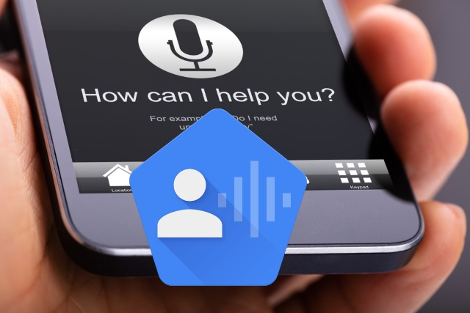
19. Voice interaction
An Voice Access application was used
The Voice Access app for Android lets you control your device with spoken commands. Use your voice to open apps, navigate, and edit text hands-free.

Slide 50
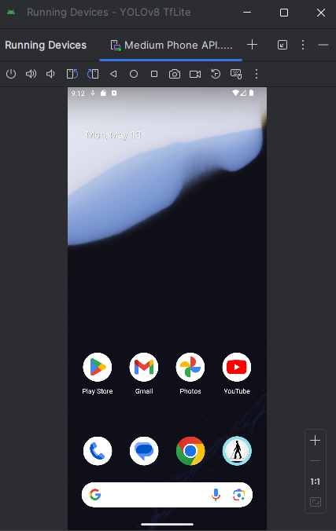
20. Practical experience
First, using a voice command, the application
is opened

Slide 51
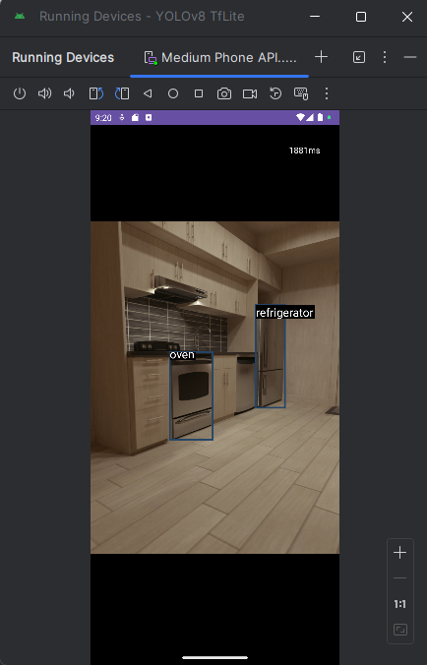
20. Practical experience
The object detection process takes place directly

Slide 52
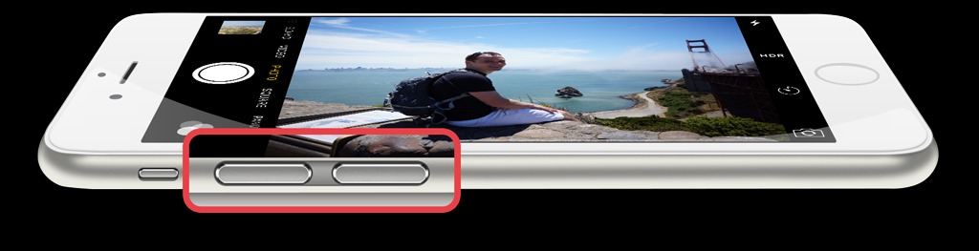
20. Practical experience
The blind person will have several options
1. Press the volume down button twice to turn on voice
reading for larger objects
2. Press twice more to stop the sound
3. Press the volume up button twice to close the
application

Slide 53
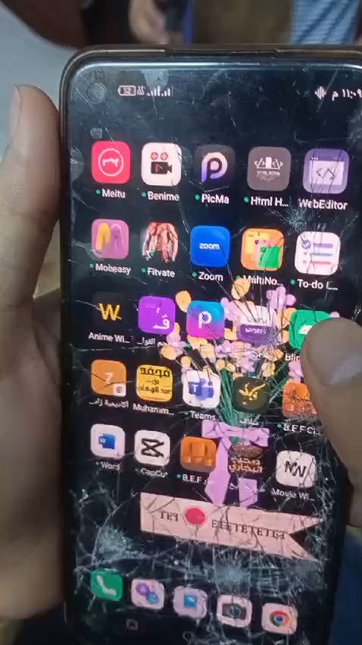
20. Practical experience
Video:

Slide 54
21.TIME PLAN AND Responsibility
Second semester
6 week
1- Search for a suitable language for work and take intensive courses to start building the application.
2 weeks
1 weeks
1 weeks
2- Work on including a way to restrict the reading process(distance Measurement)
3- Work on voice interaction
4- Final testing of the application and adding the necessary improvements

Slide 55
22.CONCLUSIONS
What is more important than starting a project is the
appropriate choice of the general problem, which may solve a real problem of importance and not a luxury
item
After completing this project. We will have a prototype to help the blind in their daily tasks. This project will
be suitable for all ages and situations, and it will be
easy to improve it in the future, God willing.

Slide 56
23. References
1- Quotations from :
United Nations website https://www.un.org/ar/observances/braille-da
(the first paragraph)
Psychology website https://kenanaonline.com/users/alenshasy/posts/
(the first paragraph)
the seventh day https://www.youm7.com/story/2023/
(Second paragraph)
viso https://viso.ai/deep-learning/yolov8-guide/
The ministry of communications https://mcit.gov.eg/ar
2- Used in work :
Ultralytics Model https://github.com/ultralytics
Gtts https://pypi.org/project/gTTS/
Kotlin https://kotlinlang.org/
Voice Access https://play.google.com/store/apps/details?id=com.google.android.apps.accessibility.voiceaccess&hl=en

Slide 57
THANKS
FOR YOUR ATTENTION!

